Slide 1
ECONOMIC SURVEY MANAGEMENT SYSTEM USING
C LANGUAGE

Slide 2
OUR TEAM
AYESHA ANJUM (FA25_BED_035)
AYESHA SAJID (FA25-BED-036)
ILSA ALI (FA25_BED_059)
KIRAN GULZAR (FA25_BED_062

Slide 3
ABSTRACT
The “Economic Survey Management System” is a C language based project developed to manage and analyze household economic data efficiently. The system stores information related to household income, expenses, and savings using structures and arrays. It provides different functionalities such as displaying records, calculating average income, identifying the highest income household, and searching records by household ID.
The main purpose of this project is to apply programming concepts for basic economic data analysis. The project uses important concepts of C language including functions, loops, arrays, structures, and conditional statements. Savings are automatically calculated by subtracting expenses from income, while the system also checks whether a household falls below the poverty line or is economically stable.
This project is simple, user-friendly, and suitable for beginners who want
practical implementation of C programming concepts along with
economic data management and analysis.

Slide 4
INTRODUCTION
The “Economic Survey Management System” is a C-language project developed to manage and analyze household economic data. This system stores information about households, including their income, expenses, and savings.
The project supports simple economic analyses such as:
Average income calculation
Highest income identification
Poverty line checking
Household searching
This project demonstrates the practical implementation of programming
concepts alongside basic economic data analysis.

Slide 5
OBJECTIVES
To store household economic records
To calculate savings
To analyze household income
To search records efficiently
To practice C language concepts

Slide 6
FEATURES OF
THE PROJECT
Add household data
Display all household records
Calculate average income
Find highest income household
Search household by ID
Poverty line analysis

Slide 7
CONCEPTS USED
Structures
Array
Functions
Loops
Conditional statements
Menu driven program
File handling

Slide 8
WORKING
User enters number of households.
User enters household data:
ID
Income
Expense
Savings are automatically calculated.
Menu options allow different operations.
User can search records and analyze data.

Slide 9
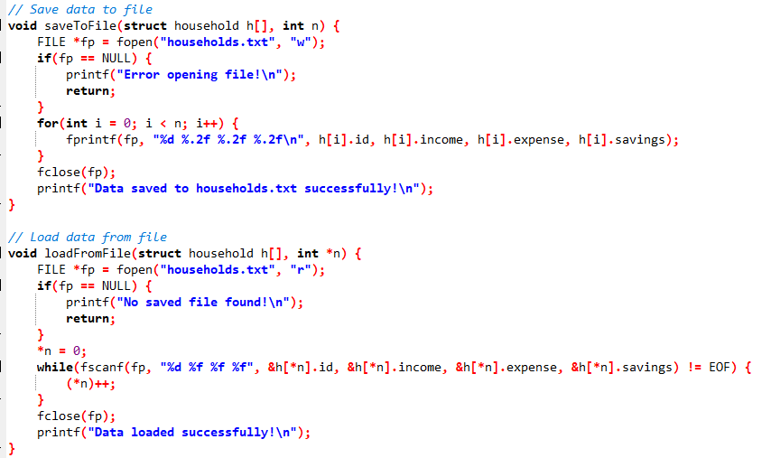
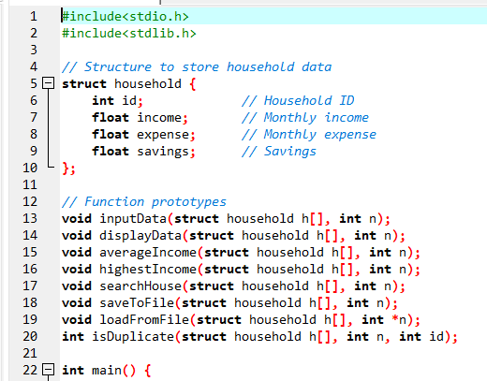
SOURCE CODE

Slide 10
SAMPLE OUTPUT
=====================================
ECONOMIC SURVEY MANAGEMENT SYSTEM
=====================================
Enter number of households: 2
Enter data for household 1
Enter household ID: 101
Enter monthly income: 50000
Enter monthly expense: 30000
Enter data for household 2
Enter household ID: 102
Enter monthly income: 25000
Enter monthly expense: 20000

Slide 11
ADVANTAGES
Simple and user friendly
Easy economic data analysis
Demonstrates major C concepts
Helpful for beginners
Useful for academic learning

Slide 12
LIMITATIONS
Limited statistical analysis
No graphical interface

Slide 13
CONCLUSION
The Economic Survey Management System is a useful C language project for managing and analyzing household economic information. The project combines programming concepts with economic data analysis and provides practical understanding of structures, arrays, functions, and loops in C language.
It is suitable for beginners and academic project submissions.

Slide 14
TOOLS AND TECHNOLOGIES
C Language
Dev C++

Slide 15
THANK
YOU

